Slide 1
CQC Single Assessment Framework
Preparing for the new approach

Slide 2
01
Introduction
02
What is staying the same
03
What is changing
04
Quality Statements
05
Evidence Categories
06
Ratings & Reporting

Slide 3
Workshop Objectives
Understand more about the new CQC Single Assessment Framework, what is changing and what you can do to prepare as a Leader
Understand more about the new CQC Single Assessment Framework, what is changing and what we are doing to prepare your Teams.
Prepare for potential ‘ Staff & Leadership Feedback Questioning’ from the CQC
Understand the types of questions as Leaders you may be asked and how this could happen.

Slide 5
Background
Published in May 2021, CQC’s new strategy sets out the regulator’s ambitions under 4 themes:
1. People and communities
Advocate for change, regulation driven by people’s needs and their experiences of health and care services, rather than how providers want to deliver them. Focusing on what matters to the public, and to local communities, when they access, use and move between services. Working in partnership with people who use services, an opportunity to help build care around the person: CQC want to regulate to make that happen.
2. Smarter regulation
Smarter in how they regulate. Keeping pace with changes in health and care, providing up-to-date, high-quality information and ratings for the public, providers and partners. Regulate in a more dynamic and flexible way to adapt to the future changes that can be anticipated – as well as those that can’t. Smarter use of data means targeting of resources to have the greatest impact, focusing on risk and where care is poor, to ensure we’re an effective, proportionate and efficient regulator.
3.Safety through learning
Stronger safety and learning cultures. Safety is still a key concern as it’s consistently the poorest area of performance in CQC assessments. Prioritise safety: stronger safety cultures, focusing on learning, improving expertise, listening and acting on people’s experiences, and taking clear and proactive action when safety doesn't improve.
4.Accelerating improvement.
Drive improvements across individual services and systems of care. Use unique position to spotlight the priority areas that need to improve and enable access to support where it’s needed most. Empower services to help themselves, while retaining a strong regulatory role.
The key to this is by collaborating and strengthening relationships with services, the people who use them, and our partners across health
and care.
Notes:
Realisation of its strategy
-Easier for people to tell CQC
Better use of Tech
Ensuring staff know how to get
Aim to work closely with providers
In April 2023 , the CQC stated it was Complex

Slide 7
Why is it changing ?
To have a greater focus on care across Local Areas or ‘Systems’
To use new regulatory powers effectively to improve people’s care
To make regulation less complex and more efficient
To regulate in a smarter , technology driven way
To work better with the sector as it changes and recovers from CV-19

Slide 8
New Powers
The CQC now have new powers to oversee local authorities and integrated care systems under the Health and Care Act 2022. It will be based on three key themes for assessment:
Support to deliver the objectives in their strategy of how care provided in a local system is improving outcomes & reducing inequalities
Transformative in how they bring together a view of quality across a local area/system.
With the new powers, it creates a duty for CQC to enforce the NHS food and drink standards.
Notes:
Leadership. Integration. Quality and Safety.
The Bill imposes requirements on NHS hospitals in connection with food or drink on hospital premises in England that are used in connection with the carrying on of a regulated activity.
Further regulations will be made which will specify the nutritional standards or requirements which are to be complied with.

Slide 9
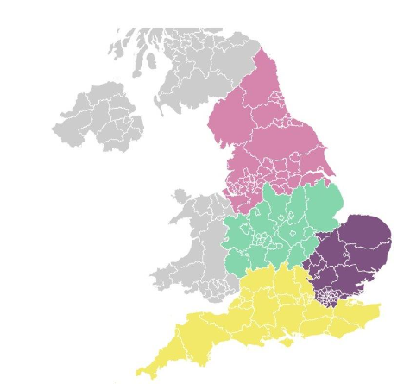
Internal CQC Changes
CQC have undergone a massive change in structure to support the single assessment framework and new strategy. Merging staff from all the different sectors together as they will be using the same framework. CQC believe that this is beneficial.
There will be four geographic areas:
South, East (including London)
South West
Midlands
North
Across the country there will be between 110- 115 teams with approx. 12 staff in each team. This is to align themselves better to the 42 ICS’s.
Notes:
CQC has not stated whether services will continue to have the same named inspector, but it is felt that it will be unlikely, as teams become more generic, with the focus on assessing evidence and any associated risk.

Slide 10
New CQC Teams
Teams will be a mix of inspectors, assessors, co-ordinators and regulatory officers.
A Team approach will be adopted by the CQC.
Supported by senior specialists
National Operations
Supported by a Central Hub
Regulatory Teams
Led by the Chief Inspectors, and focuses on raising standards, policy oversight, and external influence
Operational Teams
Work across four geographic networks, with a mix of specialist skills and knowledge to regulate in a way that mirrors how care is delivered
Notes:
CQC have stated that you will be able to speak to all members of the team but not clear how this will happen.

Slide 11
What is staying the same?
The 5 Key Questions
Ratings Categories
The 5 Key Questions
Ratings

Slide 12
What is changing?
A single framework - the same criteria for all services
Old system (4 Frameworks)
New system
One Single Assessment Framework for all providers, local authorities, and integrated care systems

Slide 13
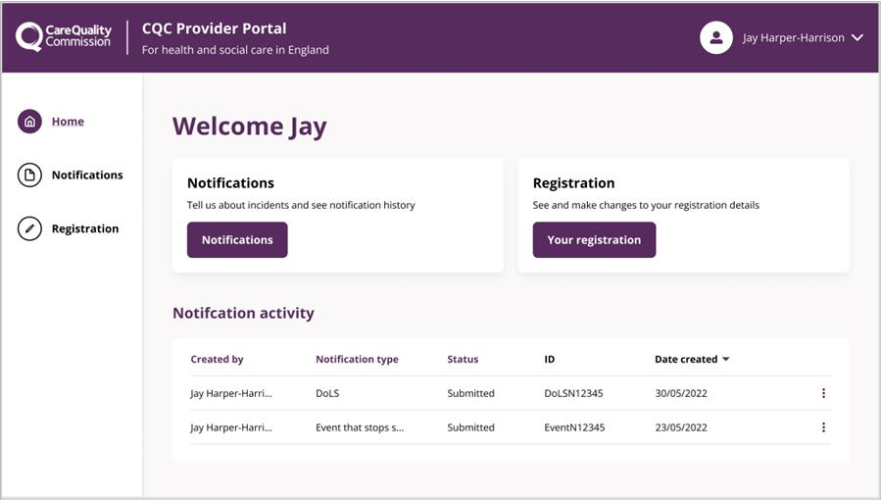
What is changing?
New Provider Portal
Will be the way you give all interactions to the CQC
Enables you to share info in real-time and provide comment on the information the CQC holds on you
As of 1st Nov 2023, majority of providers have not yet received an invitation to the portal
Still unclear limits of what can be uploaded
New Portal
Old system

Slide 14
What is changing?
New Provider Portal
From August limited providers have been able to:
Enrol to the portal
Submit four types of notification:
SN18 Serious Injury
SN18 Events that stop service
SN16 Deaths
SN18 Deprivation of Liberty Safeguards (DoLS)
Register with CQC for the first time
Carry out registration variation activity
Submit all types of notification
Delegate access to colleagues in your organisation
From November selected invited providers will be able to:
New Portal
Old system

Slide 15
What is changing?
New Provider Portal –Key Dates (subject to review)
New Portal
21 November 2023: Early Adopters. (14 services) in the South Region
5 December 2023: The remainder of the South Region
5 December 2023: Using the new assessment approach across Bedfordshire, Luton and Milton Keynes ICS area
9 January 2024: London & East Region
6 February 2024: North & Midlands region & NHS Trust Well-Led Assessments everywhere
Old system

Slide 16
What is changing?
New Provider Portal
New Portal
Old system
Target of ‘March 2024’. All providers will receive a log in to the portal
Ensure your contact details are correct

Slide 17
All 335 KLOEs are going

Slide 18
‘I’ and ‘We’ Statements 34 ‘Quality Statements replacing the KLOEs
**Not very prescriptive in how you can meet them , only steer is the different categories **
We statement (What is expected of the provider)
e.g. Safe systems, pathways and transitions
‘We work with people and our partners to establish and maintain safe systems of care, in which safety is managed, monitored and assured. We ensure continuity of care, including when people move between different services.’
I statement (What patients believe matters to them)
‘I know what to do and who I can contact when I realise that things might be at
risk of going wrong or my health condition may be worsening.’
‘When I move between services, settings or areas, there is a plan for what happens next and who will do what, and all the practical arrangements are in place.’

Slide 19
‘We Statements'
34 ‘Quality Statements replacing the KLOEs
Caring (5)
Responsive (7)
Safe (8):
Kindness, compassion and dignity,
Treating people as individuals
Independence, choice and control
Responding to people's immediate needs
Workforce wellbeing and enablement
Person-centred care
Care provision, integration, and continuity
Providing information
Listening to and involving people
Equity in access
Equity in experiences and outcomes
Planning for the future
Learning culture
Safe systems, pathways, and transitions
Safeguarding
Involving people to manage risks
Safe environments
Safe and effective staffing
Infection prevention and control
Medicines optimisation

Slide 20
‘We Statements’
34 ‘Quality Statements replacing the KLOEs
Effective (6):
Well-led (8):
Assessing needs
Delivering evidence-based care and treatment
How staff, teams and services work together
Supporting people to live healthier lives
Monitoring and improving outcomes
Consent to care and treatment
Shared direction and culture
Capable, compassionate and inclusive leaders
Freedom to speak up
Workforce equality, diversity and inclusion
Governance, management and sustainability
Learning, improvement and innovation
Partnerships and communities
Environmental sustainability

Slide 21
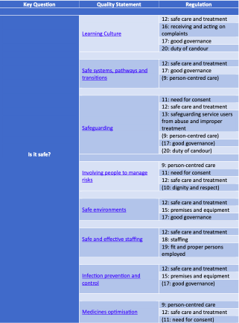
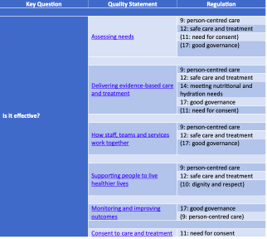
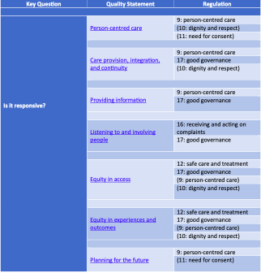
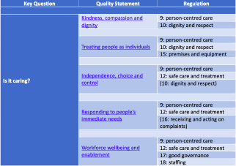
‘QS & Regulation'
34 ‘Quality Statements replacing the KLOEs
All Quality Statements will directly link to the relevant CQC Regulations

Slide 22
‘QS & Regulation'
34 ‘Quality Statements replacing the KLOEs
All Quality Statements will directly link to the relevant CQC Regulations
 | Not offences | ‘Harm’ offences | Always an offence
Person centred care ( Reg 9) | ✓
Dignity and respect (Reg 10) | ✓
Need for consent (Reg 11) |  |  | ✓
Safe care and treatment (Reg 12) |  | ✓
Safeguarding service users from abuse and improper treatment (Reg 13) |  | ✓
Meeting nutritional and hydration needs (Reg 14) |  | ✓
Premises and equipment (Reg 15) | ✓

Slide 23
‘QS & Regulation'
34 ‘Quality Statements replacing the KLOEs
All Quality Statements will directly link to the relevant CQC Regulations
 | Not offences | ‘Harm’ offences | Always an offence
Receiving and acting on complaints (Reg 16) (1)(2)) | ✓
- info to CQC re Complaints (16(3)) |  |  | ✓
Good governance (Reg 17 (1)(2)) | ✓
- Info to CQC re good governance (Reg 17(3)) |  |  | ✓
Staffing (Reg 18) | ✓
Fit and proper persons employed (Reg 19) | ✓
Duty of candour (Reg 20(2)(a) and (3)) |  |  | ✓

Slide 24
‘QS & Regulation’
Regulation 12 Safe Care & Treatment
(1) Care and treatment must be provided in a safe way for service users.
(2) Without limiting paragraph (1), the things which a registered person must do to comply with that paragraph include—
(a) assessing the risks to the health and safety of service users of receiving the care or treatment;
(b) doing all that is reasonably practicable to mitigate any such risks;
(c) ensuring that persons providing care or treatment to service users have the qualifications, competence, skills and experience to do so safely;
(d) ensuring that the premises used by the service provider are safe to use for their intended purpose and are used in a safe way;
(e) ensuring that the equipment used by the service provider for providing care or treatment to a service user is safe for such use and is used in a safe way;
(f) where equipment or medicines are supplied by the service provider, ensuring that there are sufficient quantities of these to ensure the safety of service users and to meet their needs;
(g) the proper and safe management of medicines;
(h) assessing the risk of, and preventing, detecting and controlling the spread of, infections, including those that are health care associated;
(i) where responsibility for the care and treatment of service users is shared with, or transferred to, other persons, working with such other persons, service users and other appropriate persons to ensure that timely care planning takes place to ensure the health, safety and welfare of the service users.
**2009-2023 CQC has prosecuted 134 providers (vast majority are Reg 12 or Section 10 unregulated activity) **

Slide 25
6 New Evidence Categories
Feedback from Staff and Leaders
Feedback from Partners
Observation
People's experience of health and care services
Processes
Outcomes
‘Scoring 1-4 Scale

Slide 26
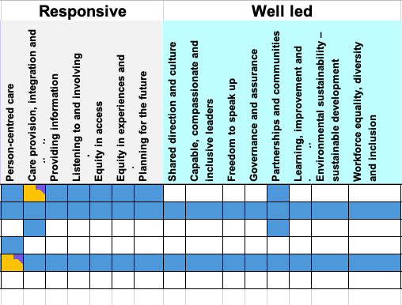
6 New Evidence Categories

Slide 27
People’s experience of Health and Care services
Direct to CQC from relatives, people using services or others
Patient Survey (FFT) Results
(and improvements made)
Evidence from you about people's experience
Responses to Concerns & Complaints
(and improvements made)
surveys, responses to concerns and improvements made

Slide 28
3. Feedback from partners
**Still unclear whether you can challenge feedback from partners **
Feedback from Partners
Commissioners
Multi Agency Bodies
Other Health & Care Providers
Visiting Health Professionals (Survey)

Slide 29
Observations of Care
Observation
Internal Observations
(e.g. Audit /Spot Checks/QA)
‘Onsite’ (aka inspection) observation of Care
Off-site/Remote interviews with
staff and professionals
Use of ‘Experts by Experience’ during site visits

Slide 30
Processes
Processes
Policy & Procedure
Patient Pathway Management
Risk Management
Patient Safety & Incidents
Complaints/
Safeguarding
Training/ Recruit
Induction/ Supervision
Audits & Action Planning
GOOD GOVERNANCE : REGULATION 17

Slide 31
Outcomes
Outcomes
Patient Outcome Data
The ‘So What’ Question
Lesson Learned /Audit Outcomes
Other Measurable Outcomes
(KPI’s, Quality Metrics etc…)

Slide 32
54%
of providers are very or extremely concerned about sharing data and action plans with CQC under the new Single Assessment Framework.
Recent Provider Survey Report 2023
Notes:
Why do you think this is?

Slide 33
Feedback from Staff & Leaders
Compliments/
Concerns shared with CQC
Staff Surveys
Onsite Inspections
Staff & Leadership Interviews
Focus Groups
PIR
Whistleblowing

Slide 34
We can gather evidence from people who work in a service either on site or off site, or by using a combination
We will carry out site visits when it’s the best way to gather the evidence we need. For example, we’ll do this to observe the care environment and how staff interact with people
Assessment teams can get quick access to specialists to support them in interviewing staff.
Inspections: We will spend our time on site speaking to people using the service and the staff.
Feedback from Staff & Leaders
What the CQC say about this
Notes:
So essentially the CQC will obtain feedback from staff both off-site and on-site. I do think, in reality the ways that the CQC gain feedback from staff will not change from the current approach. Off-site will most likely be through whistleblowing and on-site, through staff interviews.
In addition, it is unknown whether the questions that the CQC ask staff in interviews will change. The questions currently asked usually include:
If staff feel positive about their work.
About the culture of the organisation – whether it is positive, supportive, open.
If staff feel valued and listened to, particularly when they have concerns.
Currently inspectors structure their interview questions around the Key Lines of Enquiries. Therefore, it makes sense that under the new regime, interview questions will be structured around the Quality Statements.

Slide 35
Feedback from Staff & Leaders
What the CQC will ask
It is still unknown whether the questions that the CQC ask staff and leaders in interviews will change. The questions currently asked usually include:
If staff feel positive about their work.
About the culture of the organisation – whether it is positive, supportive, open.
If staff feel valued and listened to, particularly when they have concerns.
Currently inspectors structure their interview questions around the Key Lines of Enquiries. Therefore, it is highly probable that under the new regime, interview questions will be structured around the Quality Statements.
Notes:
A word of warning 3/6 evidence categories rely on feedback from others

Slide 36
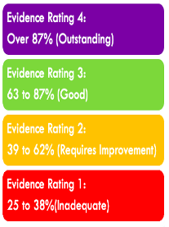
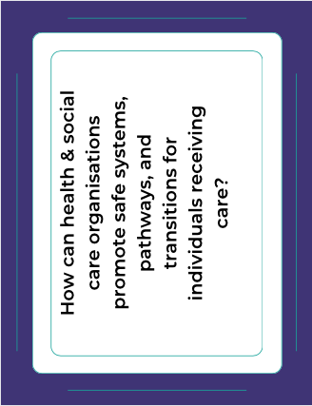
Feedback from Staff & Leaders
Activity CQC Discussion Cards
Feedback from Staff & Leaders
Activity CQC Discussion Cards
This is a role-playing exercise where you will work will be assigned a number 1 or 2 ( you must have a 1 +2 in your group)
Number 1’s will act as the CQC Inspector
Number 2’s will act as themselves
You have been provided with several QS focussed discussion cards to prompt the conversation .Your goal is to answer the questions to the best of your ability for 15 -20 minutes
After this time, we switch , Number 2’s become the CQC Inspector and Number 1’s become themselves.
CQC Inspectors please probe hard, ask follow up questions if needed ! Please rate the response from 1-4.
You will have 10 minutes at the end to reflect on your answers and discuss how you could/would improve them .
You will have an opportunity to feedback to the group.

Slide 37
Scoring & Ratings
Example Scoring 1-4 Scale

Slide 38
Scoring & Ratings
% scores will be used as a benchmarking
CQC can update ratings at any time
No mention of how the ratings review process will happen.
Rating Limiters (currently Well Led ) Still not clear if the current rating limiters will apply .
Upper and Lower limit parameters
( e.g. how far away you are from the next rating)
Example Scoring 1-4 Scale

Slide 39
What else is changing?
What Else is Changing ?
Date of inspections no longer linked to ratings
Ratings may be changed without site visits or looking at all Quality Statements
Desktop ‘assessment’ using digital evidence collected remotely
Planned & Responsive Assessment Activity
What happen in between these activities
Proactive asking for information
Always ‘On’ framework – flexible and ‘risk based’
Notes:
Planned & Responsive Assessment Activity . How is this on-going
What happens between theses activities
Proactive asking for information

Slide 40
Reports & Reporting
Reports will become shorter !
A collection of ‘summaries and benchmarking’ will be the basis of reports
Standard automated text template will remain
Written for the public not provider
Factual Accuracy Challenging will still be in place

Slide 41
Continuous quality improvement
Q&A

Slide 42
Thank you

